Slide 1
AZYGOS SYSTEM OF VEINS
BY
Dr. F.O. IGELIGE

Slide 2
OBJECTIVES
INTRODUCTION
COURSE
RELATIONS
TRIBUTARIES

Slide 3
INTRODUCTION
The azygos vein is a major vein located along the right side of the thoracic vertebral column.
It originates from the union of the right lumbar vein and the right subcostal vein or as a continuation of the inferior vena cava.
It ascends through the posterior mediastinum, running upward along the right side of the vertebrae, behind the esophagus and in front of the thoracic aorta.

Slide 4
INTRODUCTION CONT’D
The azygos vein receives blood from the posterior intercostal veins, hemiazygos vein, and accessory hemiazygos vein.
It arches over the root of the right lung before draining into the superior vena cava, which carries blood back to the heart.

Slide 5
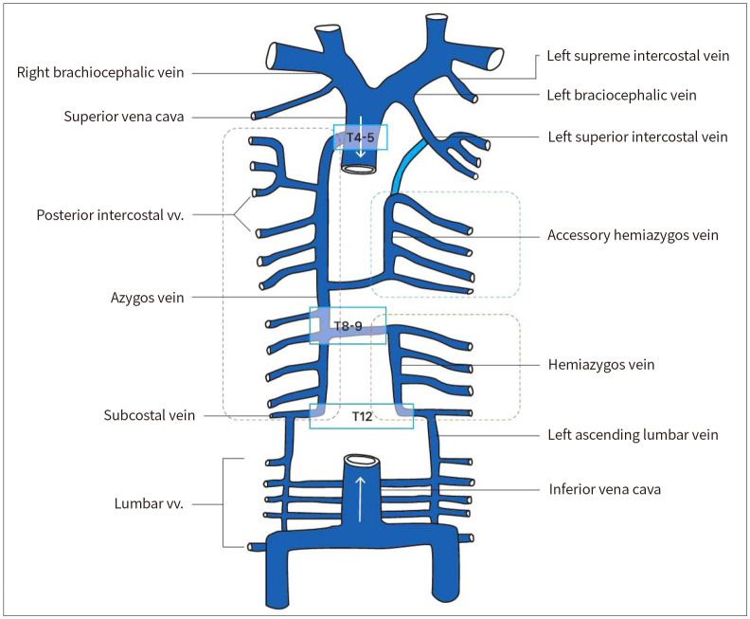

Slide 6
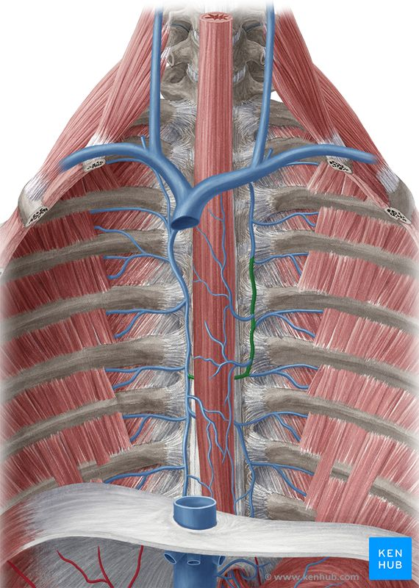

Slide 7
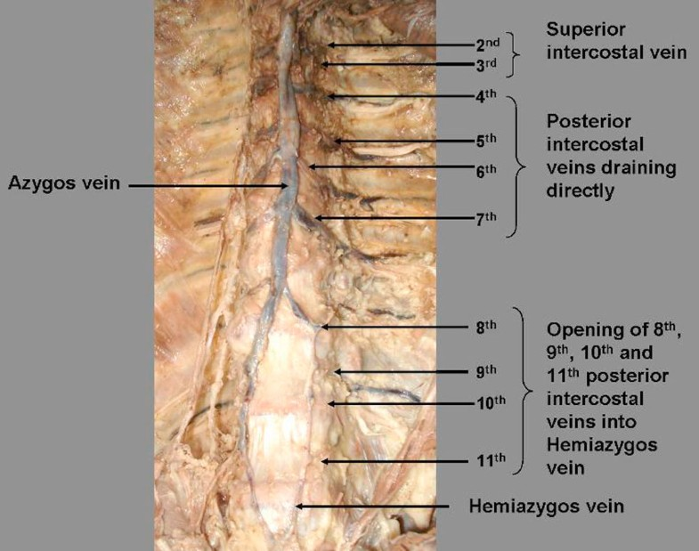

Slide 8
ORIGIN ; The azygos vein typically arises from the right ascending lumbar vein and the right subcostal vein at the level of the first or second lumbar vertebra.
In some cases, it can originate as a direct continuation of the inferior vena cava.
The exact point of origin can vary, but it is usually found in the lower part of the thorax or upper abdomen.
The vein begins in the posterior abdominal wall and ascends toward the thorax through the aortic hiatus of the diaphragm, entering the thoracic cavity.

Slide 9
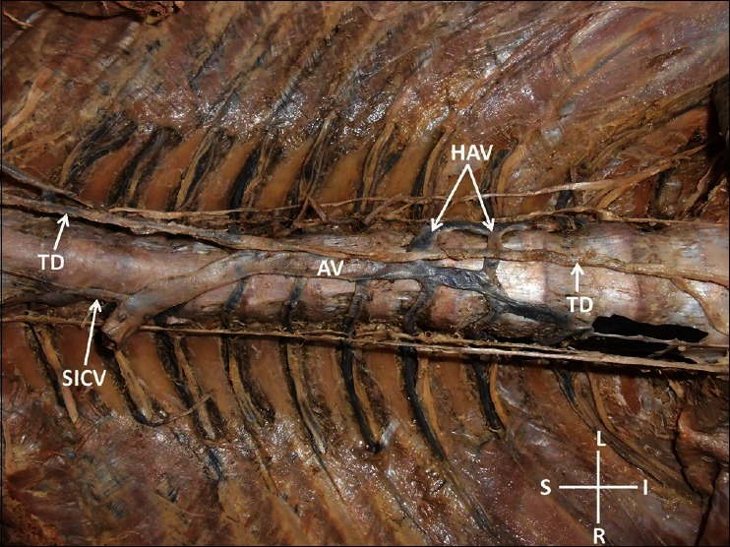

Slide 10
COURSE
The azygos vein ascends vertically along the right side of the thoracic vertebral column. It runs in the posterior mediastinum, a region located between the lungs, behind the heart and in front of the thoracic vertebrae.
As the vein ascends, it lies posterior to the esophagus and to the right of the thoracic duct.
The azygos vein runs along the right side of the vertebral bodies, closely associated with the thoracic vertebrae, and receives tributaries from various veins as it ascends.

Slide 11
Course Cont’d ...
At around the level of the T4 vertebra, the azygos vein curves forward, forming the azygos arch.
This arch passes over the root of the right lung and empties into the superior vena cava, which then carries the blood back to the heart.
The vein travels in the mediastinum between the azygos arch and the right lung before making this connection.

Slide 12
ANATOMICAL RELATIONS
posterior to the azygos vein:
the anterior longitudinal ligament
right posterior intercostal arteries
the bodies of T4-T12
In the posterior thorax, the azygos vein is located posterior to the recess of the right pleural sac and the oesophagus.
M​edially:
the thoracic duct
Aorta
Oesophagus
Trachea
right vagus nerve
laterally :
the right greater splanchnic nerve
Lung
pleura
Notes:
Anterior relations: Anterior to the azygos vein is the esophagus, which runs along the same vertical axis but is positioned more anteriorly in the posterior mediastinum. The right lung root is also anterior to the azygos vein, where the vein forms an arch over it as it empties into the superior vena cava.

Slide 13
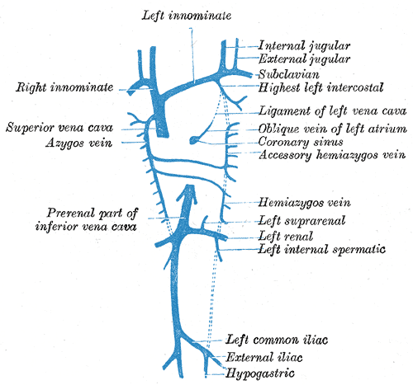
ANATOMICAL RELATIONS

Slide 14
Tributaries
The azygos vein receives blood from multiple tributaries throughout its course, including:
1. Posterior intercostal veins: These veins drain the intercostal spaces between the ribs and contribute to the azygos vein. On the right side, the posterior intercostal veins directly empty into the azygos vein.
2.Hemiazygos vein: The hemiazygos vein drains the lower left thoracic wall and passes across the midline to join the azygos vein, usually around the level of the T8 vertebra.
3.Accessory hemiazygos vein: This vein drains the upper left thoracic wall and similarly crosses to join the azygos vein, typically around the level of the T7 or T8 vertebra.

Slide 15
4.Esophageal veins: Veins from the esophagus drain into the azygos vein, contributing to its flow.
5.Mediastinal veins: These small veins drain the mediastinal structures, such as the pericardium and the lymph nodes, into the azygos vein.
6. Bronchial veins: Some of the veins that drain the bronchi and lung tissue may also empty into the azygos vein.
7. Vertebral veins: Some venous drainage from the vertebral bodies and spinal cord may enter the azygos system via smaller tributaries.

Slide 16
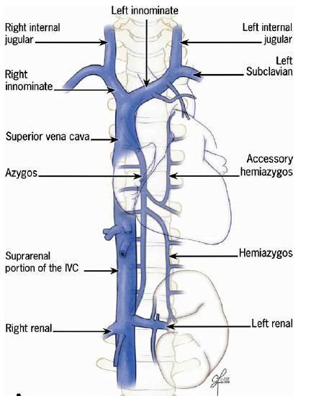
TRIBUTARIES

Slide 17
TRIBUTARIES
The hemiazygos vein is often connected to the left renal vein.
formed by the oesophageal and mediastinal tributaries, the common trunk of the left ascending lumbar vein and left subcostal vein, and by the lower three posterior intercostal veins.
It ascends anterior to the vertebral column before crossing the column posterior to the aorta, oesophagus and thoracic duct at the level of T8.
The accessory hemiazygos vein is formed by veins from the 4th to 8th intercostal spaces and sometimes by the left bronchial veins.
It descends to the left of the vertebral column before crossing T7, where it joins with the azygos vein.
Sometimes it joins the hemiazygos vein and, in this case, their common trunk drains into the azygos vein.

Slide 18
Azygos Arch
The azygos arch is a defining feature of the azygos vein’s anatomy.
As the azygos vein reaches the superior portion of the thoracic cavity, it curves anteriorly to pass over the root of the right lung.
This arch then empties into the superior vena cava at approximately the level of the fourth thoracic vertebra (T4).
The azygos arch is visible in imaging studies like chest X-rays and CT scans, and it serves as a key anatomical landmark.

Slide 19
Termination
Termination
The azygos vein terminates by draining into the superior vena cava. After forming the azygos arch, it empties into the superior vena cava just before the superior vena cava enters the right atrium of the heart.
This connection is critical for returning deoxygenated blood from the thoracic wall and posterior chest structures back to the heart for reoxygenation.

Slide 20
Variations
The anatomy of the azygos vein can exhibit variations in its origin, course, and tributaries.
Some individuals may have an azygos vein that originates directly from the inferior vena cava, while others may have variations in the level at which the hemiazygos or accessory hemiazygos veins join the azygos vein.
Additionally, in some individuals, the azygos vein may be smaller or less prominent, depending on the development of collateral venous systems. In rare cases, the azygos vein may even be duplicated.

Slide 21
CLINICAL ANATOMY
Laceration
Laceration, or ruptures of the azygos vein may occur in blunt trauma to the thorax as a result of a motor vehicle accident or a fall from a height.
Rupture of the vein usually occurs at its arch, just proximal to where it joins the superior vena cava.
Damage to the vein can result in a haemothorax, a collection of blood in the pleural space, which is usually detected by an X-ray.
If this occurs, a thoracotomy is usually indicated, which involves an incision to the chest wall to allow drainage of the blood within the pleural space.

Slide 22
Functions
1. Venous Drainage of the Thoracic Wall
2. Drainage from the Posterior Intercostal Veins
3. Venous Return from the Hemiazygos and Accessory Hemiazygos Veins
4. Drainage of the Mediastinum
5. Collateral Circulation in Venous Obstruction
6. Communication with the Vertebral Venous Plexus
7.Drainage from the Esophagus and Bronchi
8.Support for Venous Return During Respiration

Slide 23
CLINICAL ANATOMY CONT’D
Aneurysm
An aneurysm of the azygos vein is very rare and usually causes no symptoms.
They are usually detected on a chest X-ray as an abnormal mediastinal mass.
They can occur as a result of inferior vena cava obstruction, portal hypertension and congestive heart failure.
Surgical intervention is indicated when there is a risk of rupture or pulmonary embolism.

Slide 24
CLINICAL ANAT CONT’D…
Congenital defects
Rarely, the hepatic portion of the inferior vena cava does not form during embryonic development and as a result the inferior vena cava continues as the azygos vein.
This is referred to as azygos continuation of the inferior vena cava or absence of the hepatic segment of the inferior vena cava with azygos continuation.
To compensate for this congenital abnormality, the azygos vein dilates in order to accommodate for the increase in blood flow.
It occurs in 0.3% of the population and is associated with congenital heart disease or asplenia syndromes (syndromes with an absence of normal spleen function.

